Slide 1


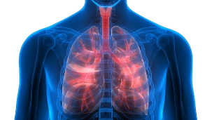
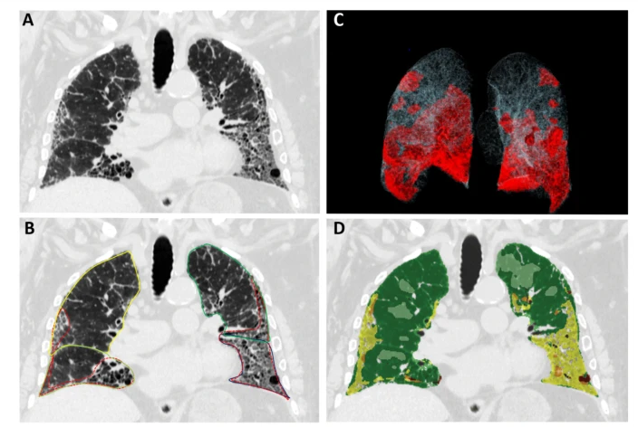
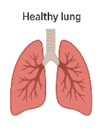
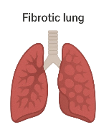







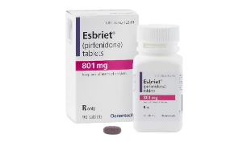
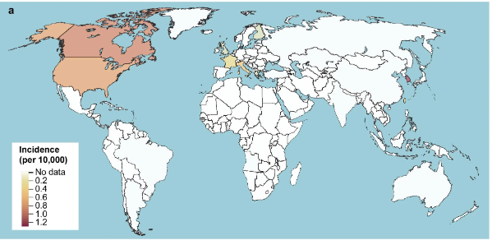
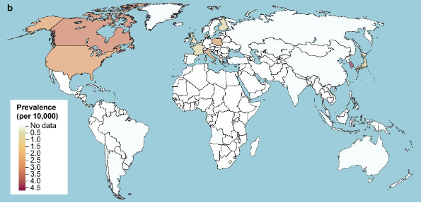
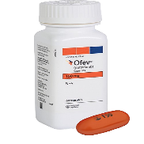
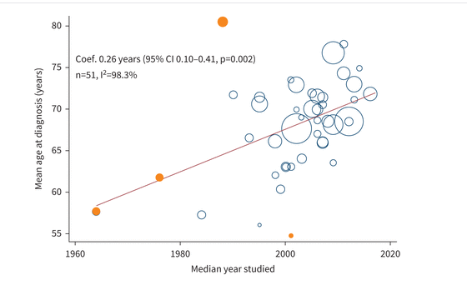

Scarred Lungs, Stolen Breath:
Opacity based quantification of fibrosis [3]
Understanding Pulmonary Fibrosis
Green area indicates healthier tissues
Gray area shows healthy tissues
Shows the baseline images for comparison
1.What is Pulmonary Fibrosis?
2.How It Disrupts Oxygen Delivery
Idiopathic pulmonary fibrosis (IPF) is an interstitial lung disease (ILD), characterized by disease progression and functional decline. [1]
Step 1
Air enters the alveoli
Step 2
Scar tissue thickens walls
Step 3
Oxygen
Diffuses
Step 4
Tissues become hypoxic
Normal airways
Unimpeded gas exchange
Thin alveolar walls
Disrupted lung architecture
Inflammation
Dilated bronchi
Poor gas exchange
Irregular, distorted air sacs
Scarred, thickened, fibrotic alveolar walls
Comparing a healthy lung to an infected lung
how pulmonary fibrosis disrupts oxygen delivery
3.Causes
4.Symptoms[1]
The causes of IPF remain unknown [1]
Shortness of breath
Dry cough
Fatigue
Chest discomfort
6.Management & Solutions
5.Facts & Figures
Oral antifibrotic drugs
Incidence[2]
Prevalence [2]
There are high incidences in North America
Incidences are moderate in Europe
Japan also has a notable value.
South Korea has the highest prevalence
Its moderate in Europe
Its also high in north America
Pirfenidone
Nintedanib
Mean age at diagnosis[5]
Antifibrotic effect on mortality [4]
Study covers years 1960- 2020
Diagnosis age increases over time
Early treatment shows low mortality
There is a stronger effect in older patients
7.References
Glass, D. S., Grossfeld, D., Renna, H. A., Agarwala, P., Spiegler, P., DeLeon, J., & Reiss, A. B. (2022). Idiopathic pulmonary fibrosis: Current and future treatment. The Clinical Respiratory Journal, 16(2), 84–96. https://doi.org/10.1111/crj.13466
Maher, T. M., Bendstrup, E., Dron, L., Langley, J., Smith, G., Khalid, J. M., Patel, H., & Kreuter, M. (2021). Global incidence and prevalence of idiopathic pulmonary fibrosis. Respiratory Research, 22(1), 197. https://doi.org/10.1186/s12931-021-01791-z
Nowak, S., Creuzberg, D., Theis, M., Pizarro, C., Isaak, A., Pieper, C. C., Luetkens, J. A., Skowasch, D., Sprinkart, A. M., & Kütting, D. (2025). Comparing multi-texture fibrosis analysis versus binary opacity-based abnormality detection for quantitative assessment of idiopathic pulmonary fibrosis. Scientific Reports, 15(1), 1479. https://doi.org/10.1038/s41598-025-85135-7
Xu, H., Hui, S. L., Lee, J. S., Zhang, Z., & Boente, R. D. (2024). Effect of Antifibrotic Use on Mortality in Patients with Idiopathic Pulmonary Fibrosis. Annals of the American Thoracic Society, 21(10), 1407–1415. https://doi.org/10.1513/AnnalsATS.202312-1054OC
Zheng, Q., Cox, I. A., Campbell, J. A., Xia, Q., Otahal, P., De Graaff, B., Corte, T. J., Teoh, A. K. Y., Walters, E. H., & Palmer, A. J. (2022). Mortality and survival in idiopathic pulmonary fibrosis: A systematic review and meta-analysis. ERJ Open Research, 8(1), 00591–02021. https://doi.org/10.1183/23120541.00591-2021

